Slide 1
VIVA-VOCE
DASHBOARD FOR REAL TIME MONITORING OF CONSTRUCTION PROJETS
Batch Number:CSE156
NAME | ROLL NO
V V PRAVEEN | 20211CSE0187
B HUSSAIN | 20211CSE0193
P DESHIK REDDY | 20211CSE0191
N RAVI | 20211CSE0194
Under the Supervision of,
Mr Asad mohammed khan,
Assistant Professor
PSCS
Presidency University
Name of the Program: CSE
Name of the HoD: Dr. Asif mohammad
Name of the Program Project Coordinator: Mr. Md Ziaur rahman
Name of the School Project Coordinators: Dr. Sampath A K
ROLL NUMBER | STUDENT NAME
20211ISD0022 | ALURU PAVAN KUMAR REDDY
20211ISD0037 | MUPPALA PRUDHVI RAJU
20211ISD0023 | ABHAY R ACHARYA

Slide 2
Introduction
The construction industry is a critical sector that involves extensive planning, coordination, and execution of complex projects. From high-rise buildings and infrastructure development to residential and commercial constructions, managing these projects requires real-time monitoring, efficient resource allocation, and seamless communication among stakeholders. Traditionally, project managers and site supervisors have relied on manual record-keeping, paper-based reports, and periodic inspections, which often result in delays, cost overruns, miscommunication, and inefficiencies. In the modern era, where real-time data and automation are transforming industries, construction management must also adopt technology-driven solutions to enhance efficiency, transparency, and decision-making.
The dashboard is designed with a modern technology stack to ensure performance, scalability, and ease of use. The frontend is built using Next.js, offering a responsive and dynamic user experience, while Zustand manages application state efficiently. Tailwind CSS is employed for styling, providing a sleek and modern UI design. The backend, if required, is developed using Node.js or Python (Flask/Django) to handle API requests and database interactions. The system supports PostgreSQL, MySQL, or MongoDB, depending on data complexity and storage needs. Real-time data synchronization is achieved through WebSockets or MQTT protocols, enabling seamless updates on construction site activities, equipment tracking, and environmental monitoring.

Slide 3
Literature Review
1.IoT-Based Real-Time Monitoring in Construction
Author(s): Zhang et al., 2020
Summary: This study explores how IoT devices, such as sensors and RFID tags, can be integrated into construction sites for real-time tracking of materials, equipment, and workers. The research highlights the benefits of IoT in improving project efficiency, reducing resource wastage, and ensuring safety compliance.
2.Digital Twin for Construction Project Management
Author(s): Lu & Chen, 2021
Summary: This paper discusses the use of digital twin technology in construction project monitoring. It explains how real-time data can be fed into a virtual model of the construction site to simulate different scenarios and predict possible delays or resource shortages.
3.Cloud-Based Project Monitoring Systems
Author(s): Patel & Gupta, 2019
Summary: The research focuses on the advantages of cloud computing in construction project management. The authors propose a cloud-based dashboard that integrates BIM (Building Information Modeling) and real-time site data, enabling seamless collaboration between stakeholders.

Slide 4
Literature Review
4.Role of AI in Predictive Construction Management
Author(s): Kim & Park, 2020
Summary: The study investigates how artificial intelligence (AI) and machine learning (ML) can analyze historical project data to predict potential risks and recommend corrective measures in construction projects.
5.Application of WebSockets for Real-Time Data Sharing
Author(s): Smith et al., 2021
Summary: This paper examines the role of WebSockets in facilitating real-time communication between construction sites and monitoring dashboards, emphasizing the advantages over traditional HTTP polling methods.
6.BIM and IoT Integration for Smart Construction
Author(s): Wong et al., 2020:
Summary: The study explores the integration of Building Information Modeling (BIM) and IoT to create a smart construction site, where real-time data is used for automated scheduling and progress tracking.

Slide 5
Research Gaps Identified
1.Limited Integration of Multiple Data Sources o Current systems often fail to integrate multiple data sources such as IoT devices, project management software, and manual inputs seamlessly. This results in fragmented data and hinders real-time decision-making.
2.Scalability Issues in Real-Time Processing o Many existing solutions struggle to handle large-scale construction projects involving multiple sites and thousands of data points. The lack of scalable architectures for real-time data processing affects performance.
3.Inefficient Handling of Real-Time Safety Monitoring o Although AI-based safety monitoring exists, real-time detection of hazards (e.g., improper PPE usage, falling objects) still has a high false-positive rate. More accurate and context-aware safety monitoring is needed.
4.Lack of Advanced Predictive Analytics for Delay Prevention o Most systems only provide historical data analysis instead of predictive insights. There is a gap in using AI/ML models to predict delays and recommend preventive measures before they occur.
5.Security and Data Privacy Concerns o Construction sites collect sensitive data related to project budgets, worker details, and infrastructure plans. Existing solutions lack robust encryption and blockchain-based security to prevent cyber threats and unauthorized access.
6.High Latency in Real-Time Communication o WebSockets and MQTT are commonly used for real-time updates, but high network latency can still delay data synchronization between the site and dashboard. Optimized edge computing solutions could address this issue.

Slide 6
Proposed Methodology
1. Multi-Source Data Integration
To achieve comprehensive real-time monitoring, the system will integrate data from multiple sources such as IoT sensors, project management tools (e.g., Jira, Asana), and manual inputs from site supervisors. APIs and data pipelines will be established to ensure seamless communication between different platforms. This integration will help in automated data collection, reducing manual effort and ensuring accurate real-time updates on construction progress, resources, and environmental conditions.
2. Real-Time Data Processing with Edge Computing
Traditional cloud-based systems often face latency issues due to network dependencies. To counter this, edge computing will be implemented to process data closer to the construction site using local servers or edge devices. This method will significantly reduce response time for safety alerts, equipment failures, and live monitoring, allowing for faster decision-making in critical situations. Edge computing also reduces cloud bandwidth usage, making the system more cost-effective.

Slide 7
Objectives
1. Enhance Real-Time Project Visibility and Tracking
The primary objective of this system is to provide real-time tracking of construction activities, ensuring transparency for all stakeholders, including project managers, site supervisors, and clients. By integrating IoT sensors, GPS tracking, and automated reporting, this system will allow instant progress updates, milestone tracking, and real-time comparisons of planned vs. actual work. This will help identify bottlenecks early, ensuring that projects stay on schedule and within budget.
2.Improve Construction Site Safety and Compliance
Construction sites are prone to hazardous working conditions. This system aims to reduce workplace accidents by integrating AI-driven computer vision, IoT-based sensors, and wearables to detect safety violations such as lack of PPE, unsafe working conditions, and worker fatigue. Automated safety compliance checks will send real-time alerts to supervisors, ensuring quick corrective actions. Additionally, it will help companies comply with labor laws and safety regulations, reducing legal risks.
3.Optimize Resource Allocation and Utilization
Efficient use of labor, materials, and machinery is crucial for costeffective project execution. This system will utilize AI and machine learning algorithms to optimize resource distribution based on real-time site requirements. By analyzing worker productivity, material availability, and equipment usage, it will ensure minimum wastage and maximum efficiency. The system will also provide automated recommendations for reallocation when shortages or excesses are detected.

Slide 8
System design & Implementation
1. Modular System Architecture Design
The system follows a modular microservices architecture, ensuring flexibility and scalability. Each module, such as Progress Tracking, Resource Management, Safety Monitoring, Financial Monitoring, and Real-Time Data Processing, operates independently and communicates via RESTful APIs or GraphQL. The frontend (Next.js) interacts with the backend (Node.js/Python) through API endpoints, ensuring smooth data retrieval, processing, and visualization. The system is designed to easily integrate with third-party services, allowing additional functionality without major rework.
2. Financial and Budget Tracking Module
The financial dashboard tracks budget allocations, actual spending, and cost overruns in real time. It integrates with accounting software (SAP, QuickBooks, or custom APIs) to pull financial records. The system categorizes expenses into materials, labor, equipment, and overheads, offering data visualizations via Recharts/D3.js. Anomaly detection models alert managers of unexpected expenses or fraudulent transactions, ensuring financial discipline.

Slide 9
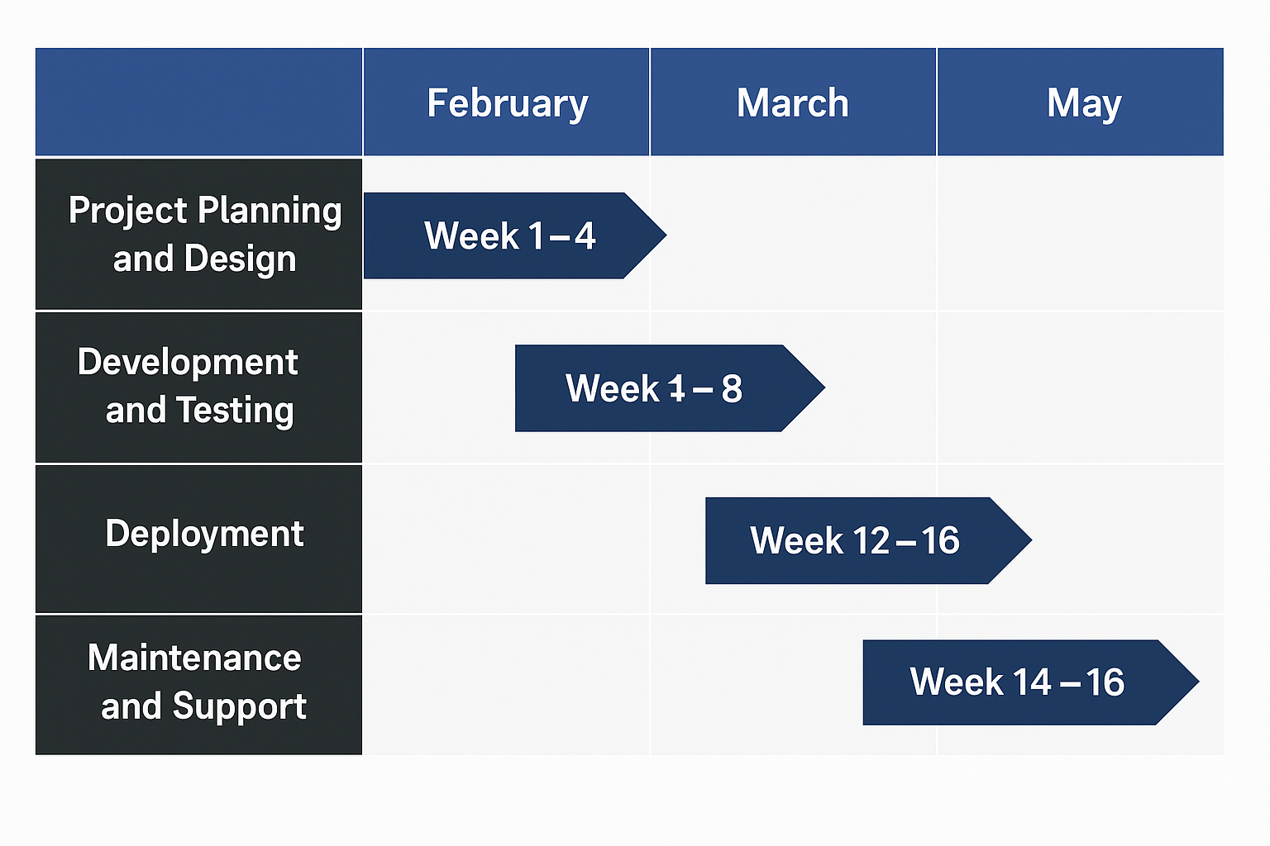
Timeline of Project

Slide 10
Outcomes/Results Obtained
Improved Project Transparency and Real-Time Insights
The dashboard provides real-time visibility into every aspect of the construction project, including progress tracking, worker activities, resource allocation, and budget updates. This eliminates manual reporting and allows stakeholders to make data-driven decisions instantly. With real-time dashboards and alerts, delays, safety concerns, and cost overruns can be identified early, ensuring proactive intervention.
Enhanced Worker Safety and Risk Mitigation
By integrating IoT sensors, AI-powered surveillance, and predictive analytics, the system significantly improves worker safety. Real-time alerts notify supervisors of potential hazards, such as poor air quality, excessive noise levels, fire risks, and worker fatigue. Additionally, helmet and safety compliance monitoring using computer vision reduces workplace accidents, ensuring adherence to safety regulations.
Optimized Resource Utilization and Cost Reduction
The system tracks equipment, materials, and workforce usage in real-time, preventing resource wastage and overuse. AI-driven recommendations optimize resource allocation, reducing downtime and idle periods. Automated financial tracking and anomaly detection for fraudulent transactions further ensure that projects stay within budget, avoiding unexpected cost escalations.

Slide 11
Conclusion
The The implementation of the Real-Time Monitoring Dashboard for Construction Projects has revolutionized the way construction sites are managed by integrating advanced data analytics, IoT sensors, real-time tracking, and AI-driven insights. The dashboard provides an interactive and centralized platform for stakeholders, enabling them to monitor progress, resource allocation, safety measures, budget adherence, and environmental factors in real-time. This significantly improves decisionmaking, operational efficiency, and project transparency.
One of the most notable benefits of this system is enhanced safety monitoring, achieved through IoT-enabled sensors and AI-powered surveillance. Real-time alerts help mitigate risks, reducing workplace accidents and ensuring compliance with safety regulations. Additionally, predictive analytics has helped minimize project delays and budget overruns, ensuring smoother project execution. The dashboard’s resource management capabilities have optimized the use of labor, equipment, and materials, thereby improving cost efficiency and minimizing waste.

Slide 12
References
Brown, Azhar, S., & Brown, J. (2009). BIM for construction safety planning. Journal of Information Technology in Construction, 14(1), 123-134.
Becerik-Gerber, B., & Rice, S. (2010). The perceived value of building information modeling in the U.S. building industry. Automation in
Construction, 19(5), 549-558.
Bryde, D., Broquetas, M., & Volm, J. M. (2013). The project benefits of building information modeling (BIM). International Journal of
ProjectManagement, 31(7), 971-980.
Chen, K., & Kamara, J. (2011). A framework for real-time construction project progress monitoring using RFID and BIM.
Automation in Construction, 20(2), 134-144.
Eastman, C., Teicholz, P., Sacks, R., & Liston, K. (2011). BIM Handbook: A Guide to Building Information Modeling for Owners, Managers, Designers, Engineers, and Contractors. John Wiley & Sons.
Hamledari, H., & Fischer, M. (2017). Automated progress monitoring using 4D BIM and computer vision-based sensing technologies. Construction Research Congress, 2017, 537-546.
Li, H., Guo, H., Skitmore, M., & Huang, T. (2018). Real-time big data analytics for the construction industry. Automation in Construction, 85, 256-273.

Slide 13
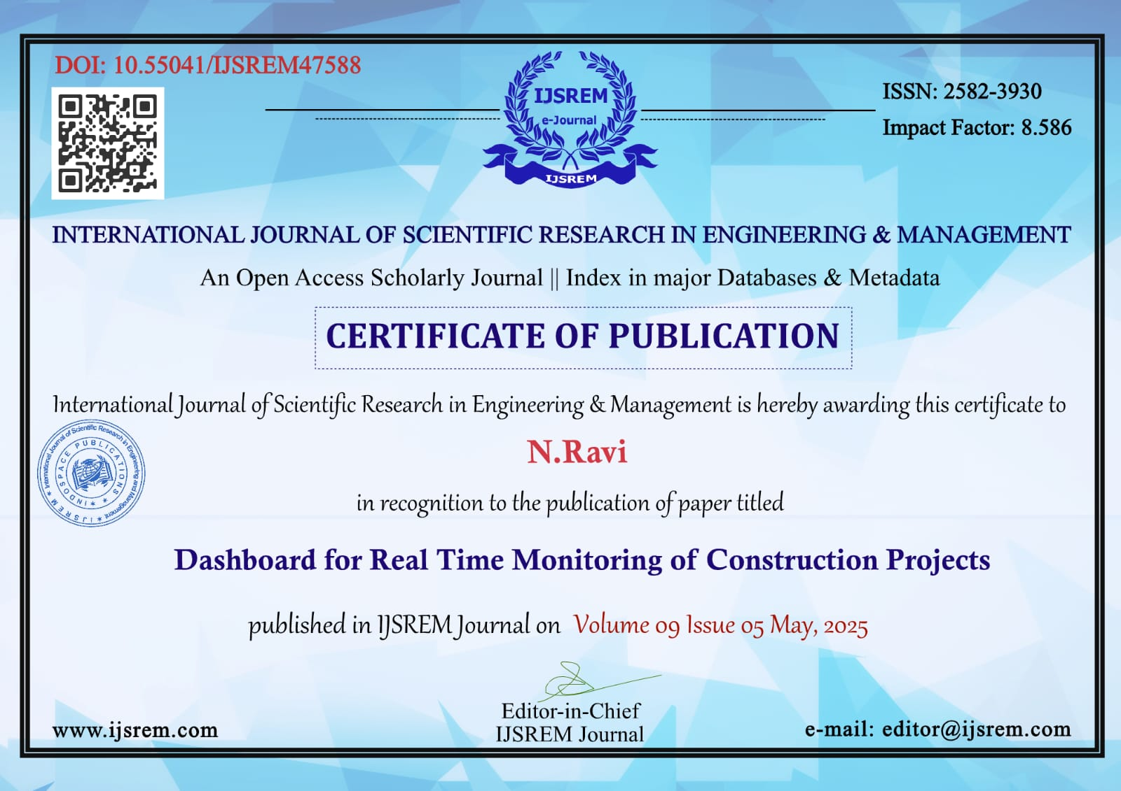
Proof of Publication

Slide 14
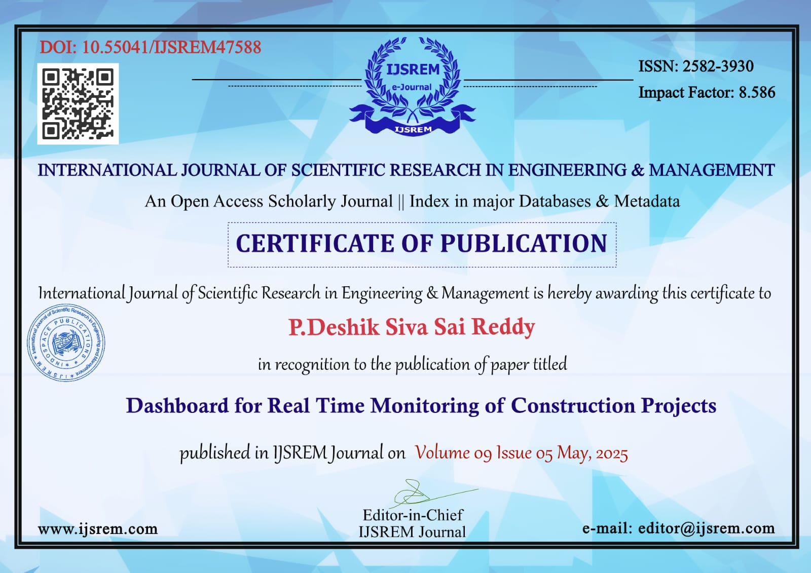

Slide 15


Slide 16


Slide 17
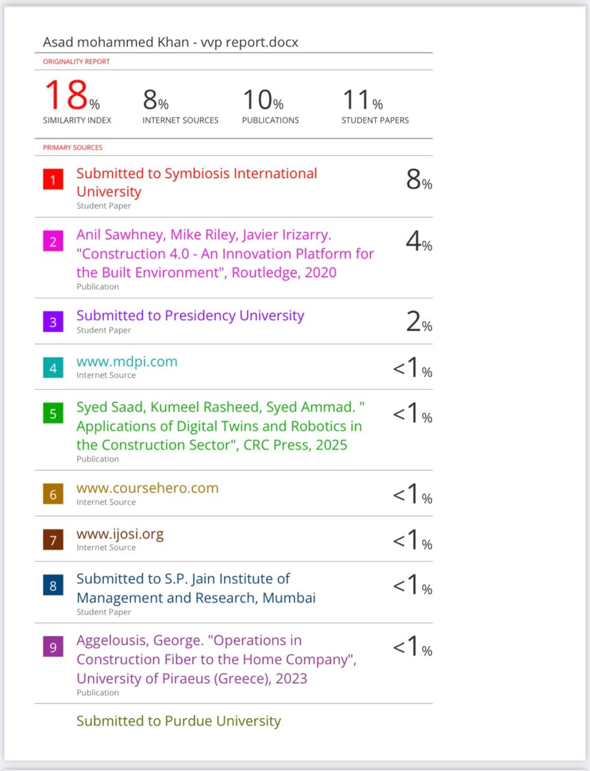
Similarity Report Index

Slide 18

SDG Mapping
The Project work carried out here is mapped to multiple SDGs:
SDG-11: Sustainable Cities and Communities:
SDG-11 aims to make cities and human settlements inclusive, safe, resilient, and sustainable. Your project aligns with this goal in several ways:
1.Efficient Resource Use in Urban Development (Target 11.3 – Sustainable Urbanization):
• Construction projects are a cornerstone of urban development. By using IoT and AI/ML to monitor resources in real time, your dashboard can reduce inefficiencies, such as idle equipment or underutilized manpower. This contributes to more sustainable urban planning and development by minimizing resource waste and ensuring projects are completed on time, which is critical for growing cities.

Slide 19
Thank You

